Slide 1
Chapter 8: Principles of Construction Design
Session I: Overview of Construction Design
Flow-, State-, and Table-Based Designs

Slide 2
Session’s Agenda
Overview of Construction Design
  Algorithmic Viewpoint
  Stylistic Viewpoint
Algorithmic Viewpoint
  Flow-based
    UML Activity Diagrams
  State-based
    UML State Diagrams
  Table-based
What’s next…

Slide 3
What is Construction Design?
Transition from the software design phase to the construction phase should occur with minimal effort.
In some cases, component designs provide enough detail to allow their transformation from design artifact to code easily.
In other cases, a more fine-grained level of design detail is required.
Construction design is the lowest level of detailed design that addresses the modeling and specification of function implementations.
  This is necessary to evaluate the quality of the system at the construction level, e.g., modifiability, testability, performance, complexity, etc.
  Construction design deals mostly with the analysis and design of algorithms. The IEEE refers to this form of design as designing using a “The Algorithmic Viewpoint” [1]

Slide 4
What is Construction Design?
The algorithm viewpoint addresses construction design from a dynamic (behavioral) perspective, which provides the description of operations (such as methods and functions), the internal details and logic of each design entity [1] .
The algorithmic viewpoint can be realized using the following:
  Graphical Designs
    Flow-based
    State-based
  Tabular Designs
    Lead to table-based design and implementation
The algorithmic viewpoint minimizes complexity during construction by providing details required by programmers to implement the function's code.

Slide 5
What is Construction Design?
A separate but closely related task performed to achieve quality at the construction level is the enforcing of styles for software construction. We’ll refer to this as the “Stylistic Viewpoint” of construction design.
  These styles play a significant role in shaping the systems’ modifiability quality attribute!
In the construction design activity, styles are used to provide a consistent approach for structuring code by defining styles for code elements, such as:
  Code formatting
  Naming conventions
  Documentation
  Etc.
The application of construction styles are mostly an activity that occurs during construction, however, due to the power of today's modeling tools, the application of styles are prevalent during the detailed design phase.

Slide 6
Why Study Construction Design?
From the algorithmic viewpoint, construction design is important because it provides the means for evaluating different implementations for a particular function before committing to it.
Behavioral designs at this level provide the means to:
  Evaluate a function's completeness, complexity, testability and maintainability.
  They also provide the means for analysts of algorithms in regard to time-space performance and processing logic prior to implementation [1]. This can have significant meaning when designing for performance!
Finally, since they provide a representation of the code through graphical and tabular ways, they increase collaborative evaluation efforts, since other members without knowledge of programming languages can evaluate the design and contribute their input.
  These collaboration efforts can lead to improvement in future phases, for example the testing phase, where construction designs can be used to generate unit test cases, or the maintenance phase, where construction designs can be used to increase knowledge and understanding of the software behavior.

Slide 7
Why Study Construction Design?
From the stylistic viewpoint, construction design is important because it provides heuristics for establishing a common criteria for evaluating the quality of the structure of code, which has direct effect on code readability, and therefore maintenance.
Code that exhibit low quality in terms of readability results in higher maintenance cost, since it requires more effort to understand [2].
Construction styles are important during the design phase so that generation of code from design models can be done correctly.
From the construction phase perspective, construction styles serve as blueprint that ensures consistency among teams of developers. Finally, as mentioned before, during the testing and maintenance phase, construction styles increase readability and understanding of the code, which results in minimized cost.

Slide 8
Behavioral Construction Design
Behavioral designs at the construction level are used to model complex logic that is unknown or difficult to understand. Popular examples include:
  Flow-based design
  State-based design
  Table-based design
Flow-Based design provide a systematic methodology for specifying the logic and structure of operations using a graphical approach. Two popular approaches for creating flow-based designs include:
  Flowcharts
  UML activity diagrams
Both work well for modeling the internal flow of routines because they can be defined using sequential process flows, loops, and other complex business logic or algorithms.
  UML activity diagrams provide powerful constructs for modeling complex logic at different stages of the SDLC, however, when applied towards modeling logic, activity diagrams are just another version of flowcharts.

Slide 9
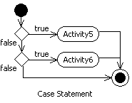
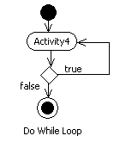
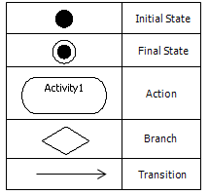
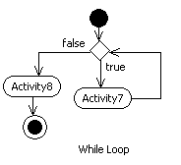
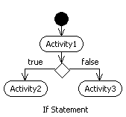
Flow-Based Construction Design
Elements in Activity Diagrams

Slide 10
State-Based Construction Design
Flow-based designs can be used to model operational logic by identifying the transitions from activity to activity required to perform an operation.
However, in some cases, the operational logic of a function or system is dictated by the different states that the system exhibits during its lifetime. That is, certain activities can only be performed when a system is in a particular state.
When this occur, the operational logic of a system can be modeled as a state machine using a (UML) state diagram.
State diagrams are typically used to model the behavior of complete system. However, in many practical applications, the state diagram acts as model for designing the logical structure of one operation that executes the state machine.

Slide 11
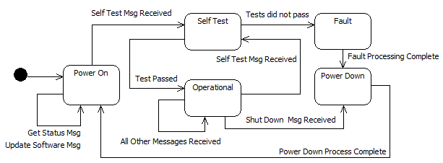
State-Based Construction Design

Slide 12
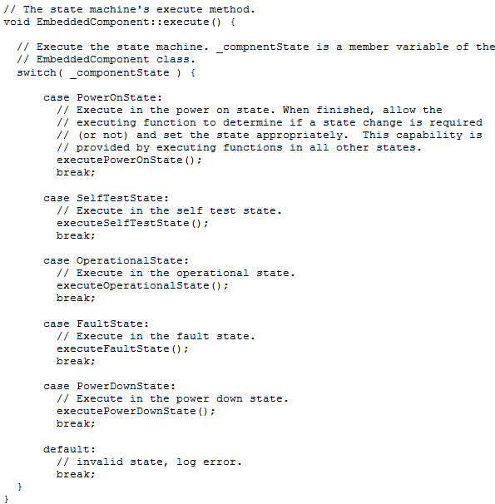
State-Based Construction Design

Slide 13
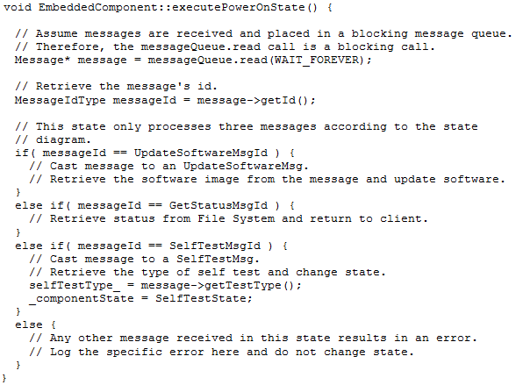
State-Based Construction Design

Slide 14
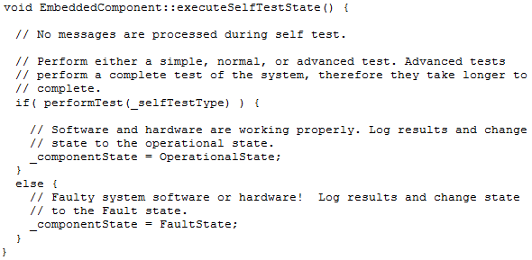
State-Based Construction Design

Slide 15
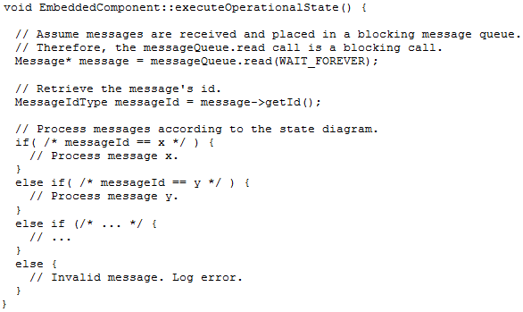
State-Based Construction Design

Slide 16
Table-Based Construction Design
Many times, the internal logic of routines are made up of complex conditional statements; each statement evaluating a condition (i.e., a cause) and providing some action (i.e., an effect) as result.
This can lead to an increasingly complex nesting structure that is error-prone, hard to read, and hard to maintain.
In these cases, the logic design can be managed using a Decision Table [3].
A decision table is a well structured table that provides the means to formulate, evaluate, improve the design of complex problems that deal with cause and effect.

Slide 17
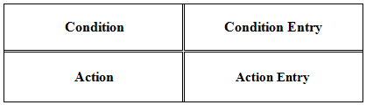
Table-Based Construction Design
The fundamental structure of a decision table contains four main sections:
  Condition
  Action
  Condition Entry
  Action Entry
The first section is the Condition section, which contains a list of all of the conditions present in the decision problem.
The second section is the Action section, which contains a list of all possible outcomes that can result from one or more conditions occurring.
The third and fourth sections are found in matrix form adjacent to the Condition and Action sections.
  The matrix adjacent to the Condition section indicate all possible combinations of conditions for the decision problem, while the matrix adjacent to the Action section indicates the corresponding actions.

Slide 18
Table-Based Construction Design
Three types of decision tables are as follow [3]:
  Limited Entry Decision Table
  Extended Entry Decision Table
  Mixed Entry Decision Table
Limited Entry Decision Table (LEDT)
  Simplest type of decision table in which the condition section of the LEDT presents Boolean conditional statements.
  That is, the condition section of the LEDT presents features of the design problem that are either present or not and their combined presence (or absence) trigger specific actions.
  Therefore, the condition entry section of the LEDT consists of Boolean values, such as true or false, or yes or no that can be used to define different policies in the decision problem.
  For a LEDT, the number of distinct elementary policies is 2^{n}, were n is the number of conditions in the condition section.

Slide 19
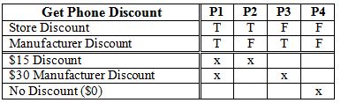
Table-Based Construction Design
Limited Entry Decision Table (LEDT) – Example
  Consider the LEDT design for a function that computes discounts for the purchase of mobile phones.
  Two types of discounts are available, a store discount of $15, and a manufacturer discount of $30.

Slide 20
Table-Based Construction Design
Sample Implementation…
WRITE THE SOURE CODE BASED ON THE GIVEN DECISION TABLE

Slide 21
Table-Based Construction Design
Extended Entry Decision Table (EEDT)
  Whereas the Condition and Action sections of LEDTs contain complete questions and actions, the Condition and Action sections of the extended entry decision table (EEDT) are extended into the Action Entry section.
  That is, in LEDTs, the Condition section contained information that could be used to ask a complete questions, such as “is there a store discount in effect?”
  In EEDT, the Condition and Condition Entry sections of the table are required to formulate a complete question, such as “Is the customer a regular, preferred, or VIP customer?”
  Similarly, the Action section must be combined with the Action Entry section of the decision table to formulate a complete action, such as “add a free car kit to the purchase.”
  In addition, the number of possible values for each condition and action in EEDTs are not bounded to two.

Slide 22
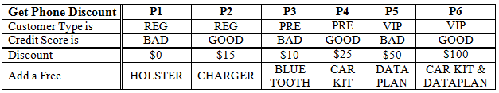

Table-Based Construction Design
Extended Entry Decision Table (EEDT) – Example
Notice that:
  The number of possible values for each condition and action in EEDTs are not bounded to two.
  Therefore, the number of policies for EEDT is the product of the number of possible values for each condition, denoted by
    Where c is the number of conditions
    V_{i} is the number of values for condition i.
  In this example, the number of policies are 3 x 2 = 6.
    3 different value types for Condition 1 (i.e., cutomer type is REG/PRE/VIP)
    2 different value types for Condition 2 (i.e., credit score is GOOD/BAD)

Slide 23
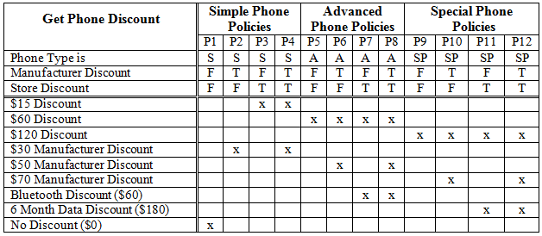
Table-Based Construction Design
Mixed Entry Decision Table (MEDT)
  Combines LEDTs and EEDTs into one MEDT
    That is, conditions can be questions, with various answers or
    Binary features that are present or not (true or false).

Slide 24
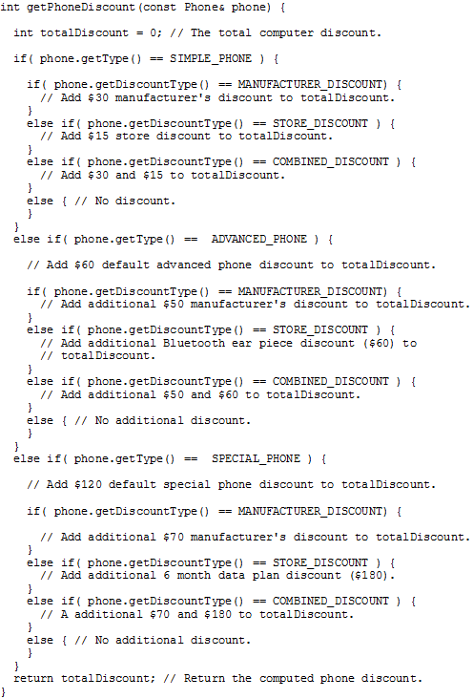
Table-Based Construction Design
These are equivalent!
That ‘s a lot of conditional statements! Let’s see how we can leverage of table-based construction to reduce complexity…

Slide 25
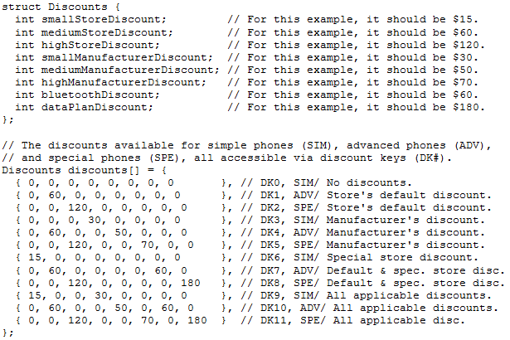
Table-Based Construction Design
Table-based designs lead to efficient construction that has significant lower complexity.
Move the complexity of the previous conditional statements to a table!

Slide 26
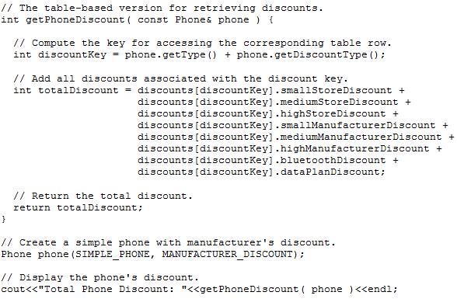
Table-Based Construction Design
Compute the discount key!
Since we moved the complexity of the previous conditional statements to a table, all we have to do now to retrieve the discount is key into the table!

Slide 27
Table-Based Construction Design
These are equivalent!
Notice how much simpler this version of the code looks!

Slide 28
What’s Next…
In this session, we presented construction design from the algorithmic viewpoint, including:
  Flow-based design
  State-based design
  Table-based design
In the next session, we will discuss another form of algorithmic design at the construction level, the Programming Design Language (PDL). We will also focuses on the stylistic view of construction design and on quality evaluation at the construction level.

Slide 29
References
[1] IEEE. “IEEE Standard for Information Technology-Systems DESIGN-Software Design Descriptions.” 2009, p. 175.
[2] Collar, Emilio Jr. “An Investigation of Programming Code Textbase Readability Based on a Cognitive Readability Model.” PhD thesis, University of Colorado at Boulder, 2005.
[3] Hurley, Richard B. Decision Tables in Software Engineering. New York: Van Nostrand Reinhold, 1982.

